Slide 1
Capstone Project Bank Marketing
By Shubham Gupta

Slide 2
Table of Content
1. Introduction
1.1 Problem Statement
1.2 Problem Description
1.3 Dataset Description
1.4 Dataset Analysis
2. Exploratory Data Analysis
2.1 Univariate analysis of output variable
2.2 Bivariate analysis
2.2.1 Categorical Features
2.2.2 Numerical Features
2.3 Checking for Multi-collinearity in input features
3. Model
3.1 Model Performance with varying parameters
3.2 Visualisation of model metrics
4. Testing of model on Sample dataset
5. Conclusion
Notes:
It has a track record of training thousands of professionals successfully via classroom and online training.

Slide 3
Problem Statement
Objective -
To predict whether a client will subscribe the term deposit or not.
Dataset Description -
The data is related with direct marketing campaigns of a Portuguese banking institution. The marketing campaigns were based on phone calls. Often, more than one contact to the same client was required, in order to access if the product (bank term deposit) would be (or not) subscribed.
Number of Instances - 45211
Number of Attribute - 16 + Output variable(y)
Missing Attribute Values - None
Notes:
It has a track record of training thousands of professionals successfully via classroom and online training.

Slide 4
Dataset Analysis
Sr. No. | Variable Name | Description | Variable Type
1 | age | Client age | Numerical
2 | job | Type of job | Categorical
3 | marital | Marital Status | Categorical
4 | education | Level of education | Categorical
5 | default | Has credit in default? | Categorical
6 | balance | Average yearly balance? | Numerical
7 | housing | Has housing loan? | Categorical
8 | loan | Has personal loan? | Categorical
9 | Contact | Contact communication type | Categorical
10 | day | Last contact day of month | Numerical
11 | month | Last contact month of year | Categorical
12 | duration | Last contact duration | Numerical
13 | campaign | Number of contact perform during this campaign for this client | Numerical
14 | pdays | No. of days passed by after the client was last contacted from a previous campaign. | Numerical
15 | previous | No. of contacts performed before this campaign for this client | Numerical
16 | poutcome | Outcome of previous campaign | Categorical
17 | Y | Has the client subscribed a term deposit or not? | Categorical
Notes:
It has a track record of training thousands of professionals successfully via classroom and online training.

Slide 5
Dataset Analysis
No. of Categorical Variables - 9 + output variable
No. of Numerical Variables - 7
Important Statistical Metrics of Numerical Variables
 | age | balance | day | duration | campaign | pdays | previous
count | 45211.000000 | 45211.000000 | 45211.000000 | 45211.000000 | 45211.000000 | 45211.000000 | 45211.000000
mean | 40.936210 | 1362.272058 | 15.806419 | 258.163080 | 2.763841 | 40.197828 | 0.580323
std | 10.618762 | 3044.765829 | 8.322476 | 257.527812 | 3.098021 | 100.128746 | 2.303441
min | 18.000000 | -8019.000000 | 1.000000 | 0.000000 | 1.000000 | -1.000000 | 0.000000
25% | 33.000000 | 72.000000 | 8.000000 | 103.000000 | 1.000000 | -1.000000 | 0.000000
50% | 39.000000 | 448.000000 | 16.000000 | 180.000000 | 2.000000 | -1.000000 | 0.000000
75% | 48.000000 | 1428.000000 | 21.000000 | 319.000000 | 3.000000 | -1.000000 | 0.000000
max | 95.000000 | 102127.000000 | 31.000000 | 4918.000000 | 63.000000 | 871.000000 | 275.000000
Notes:
It has a track record of training thousands of professionals successfully via classroom and online training.

Slide 6
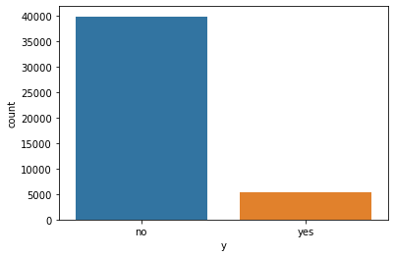
Exploratory Data Analysis
Univariate Analysis of Output Variable(y)
39922
5289
Success rate is almost 11-12% only
Bank is doing cold calling in this campaign as success rate is very less
Notes:
It has a track record of training thousands of professionals successfully via classroom and online training.

Slide 7
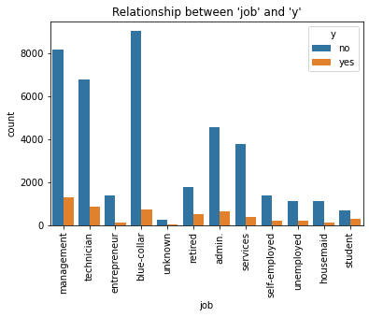
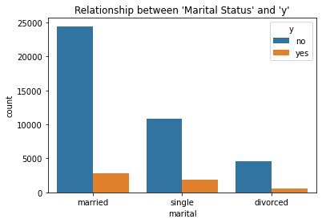
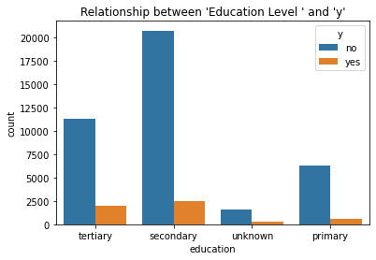
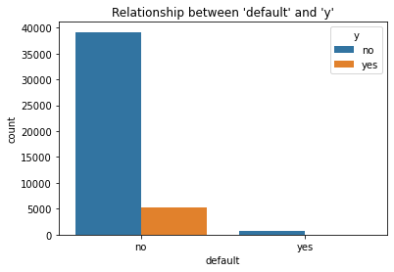
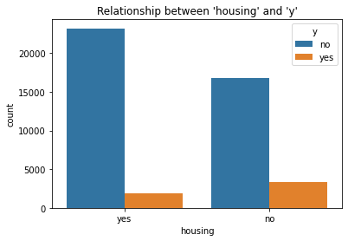
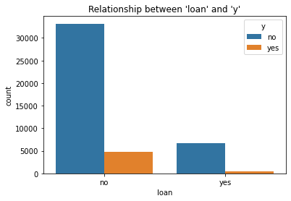
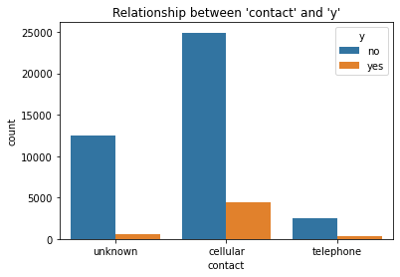
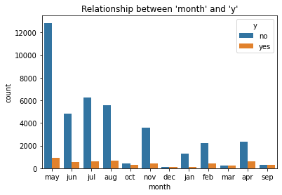
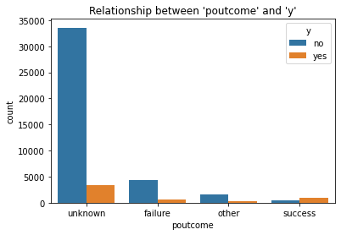
Exploratory Data Analysis
Bivariate Analysis of Output Variable with Categorical Variable
2
Notes:
It has a track record of training thousands of professionals successfully via classroom and online training.

Slide 8
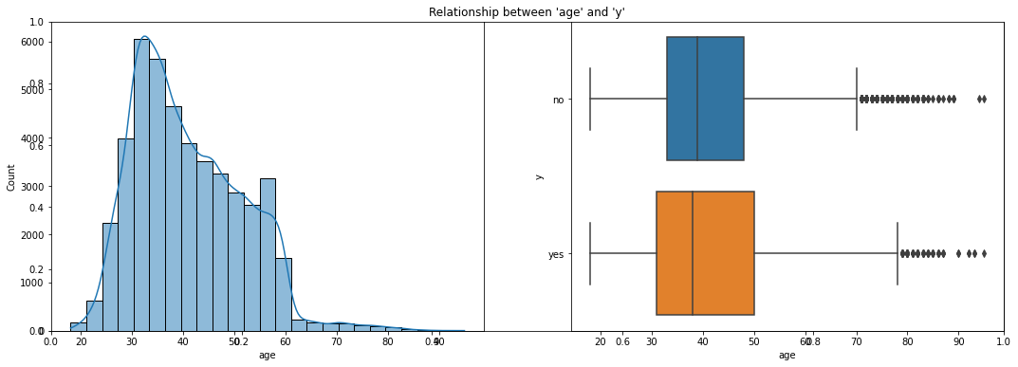
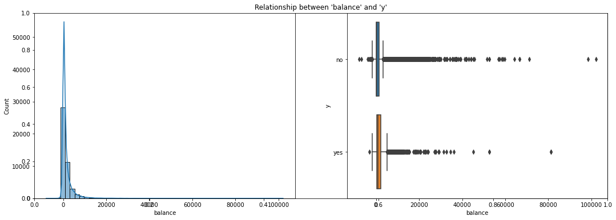
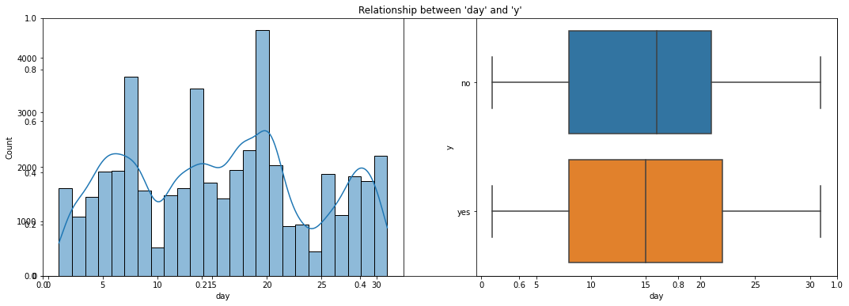
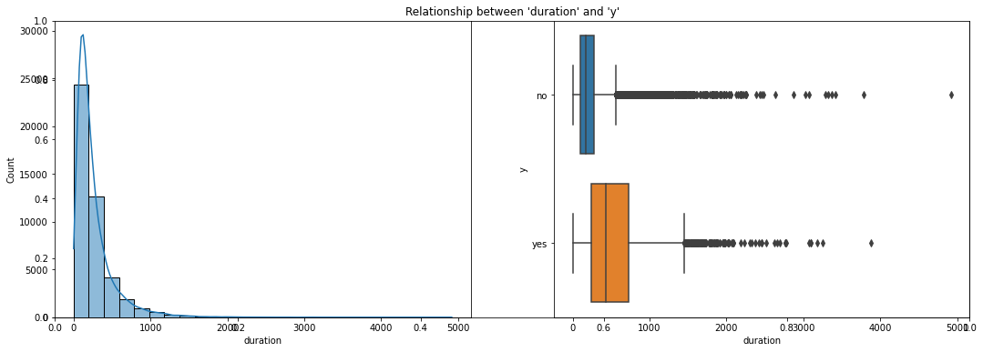
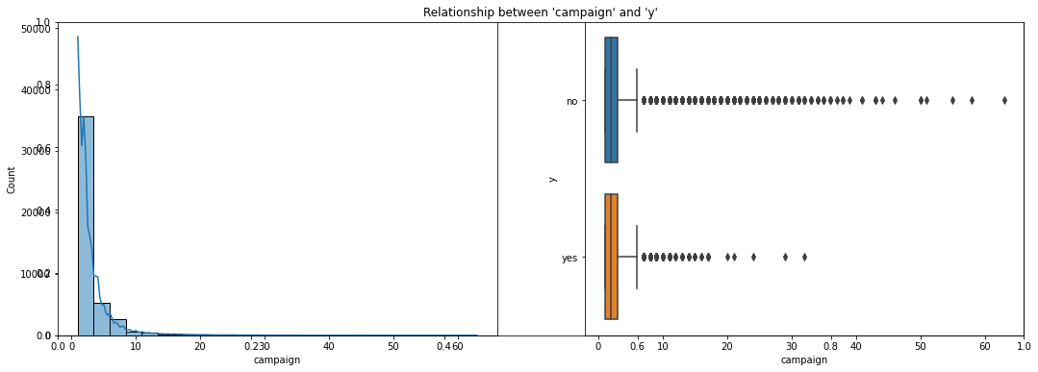
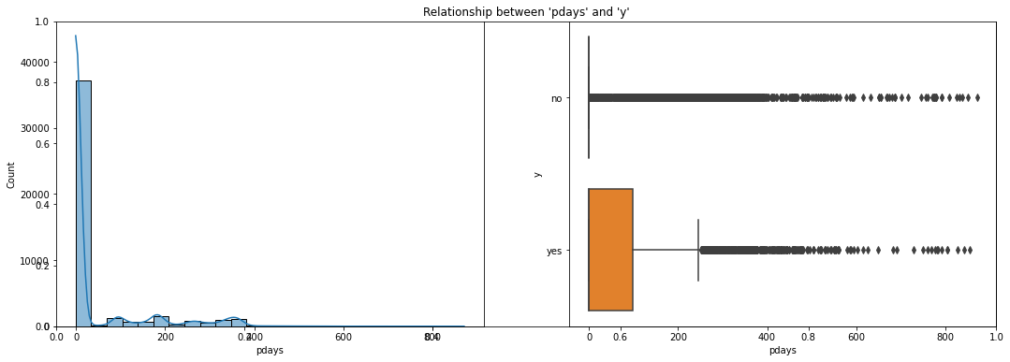
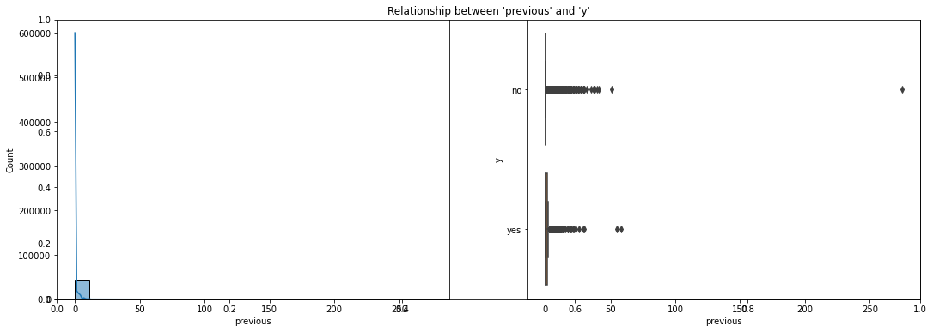
Exploratory Data Analysis
Bivariate Analysis of Output Variable with Numerical Variable
‘age’ and ‘y’
‘balance’ and ‘y’
2
‘day’ and ‘y’
‘duration’ and ‘y’
‘campaign’ and ‘y’
‘pdays’ and ‘y’
‘previous’ and ‘y’
Notes:
It has a track record of training thousands of professionals successfully via classroom and online training.

Slide 9
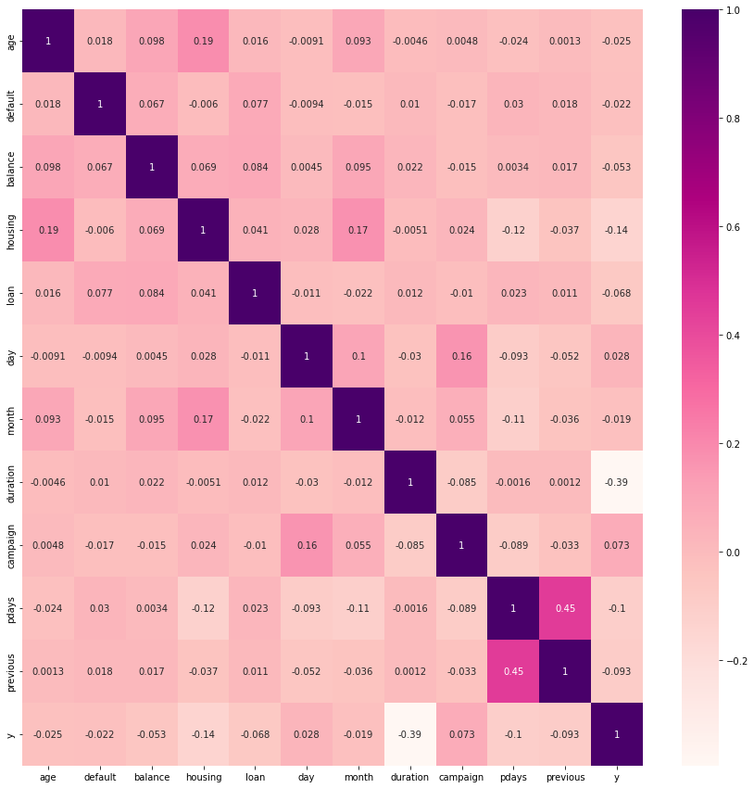
Heatmap
2
Notes:
It has a track record of training thousands of professionals successfully via classroom and online training.

Slide 10
Feature Selection
By EDA and Study of correlation using heatmap ,following features are selected for model building-
job
marital
education
default
housing
loan
poutcome
contact
age
balance
Eliminated Features-
month
day
duration
campaign
pdays
previous
2
Notes:
It has a track record of training thousands of professionals successfully via classroom and online training.

Slide 11
Challenges in Data
Computational power for more than 40000 data
Presence of mixed variable. Categorical and numerical.
2
Appraoaches and technique used
Converting categorical variable to numerical using
1) Replace Method
2) Dummy variable technique.
Notes:
It has a track record of training thousands of professionals successfully via classroom and online training.

Slide 12
Model Building
The target variable has two outcome i.e. either Yes(Client will subscribe term deposit) or NO(Client will not subscribe term deposit).
So basically, we have to build Classification model .
We develop following model and compare there performance to choose the best out of them.
Logistic Regression Model
K Nearest Neighbor Model
Support Vector Classifier
Naive Bayes Model
Random Forest Classifier
2
Notes:
It has a track record of training thousands of professionals successfully via classroom and online training.

Slide 13
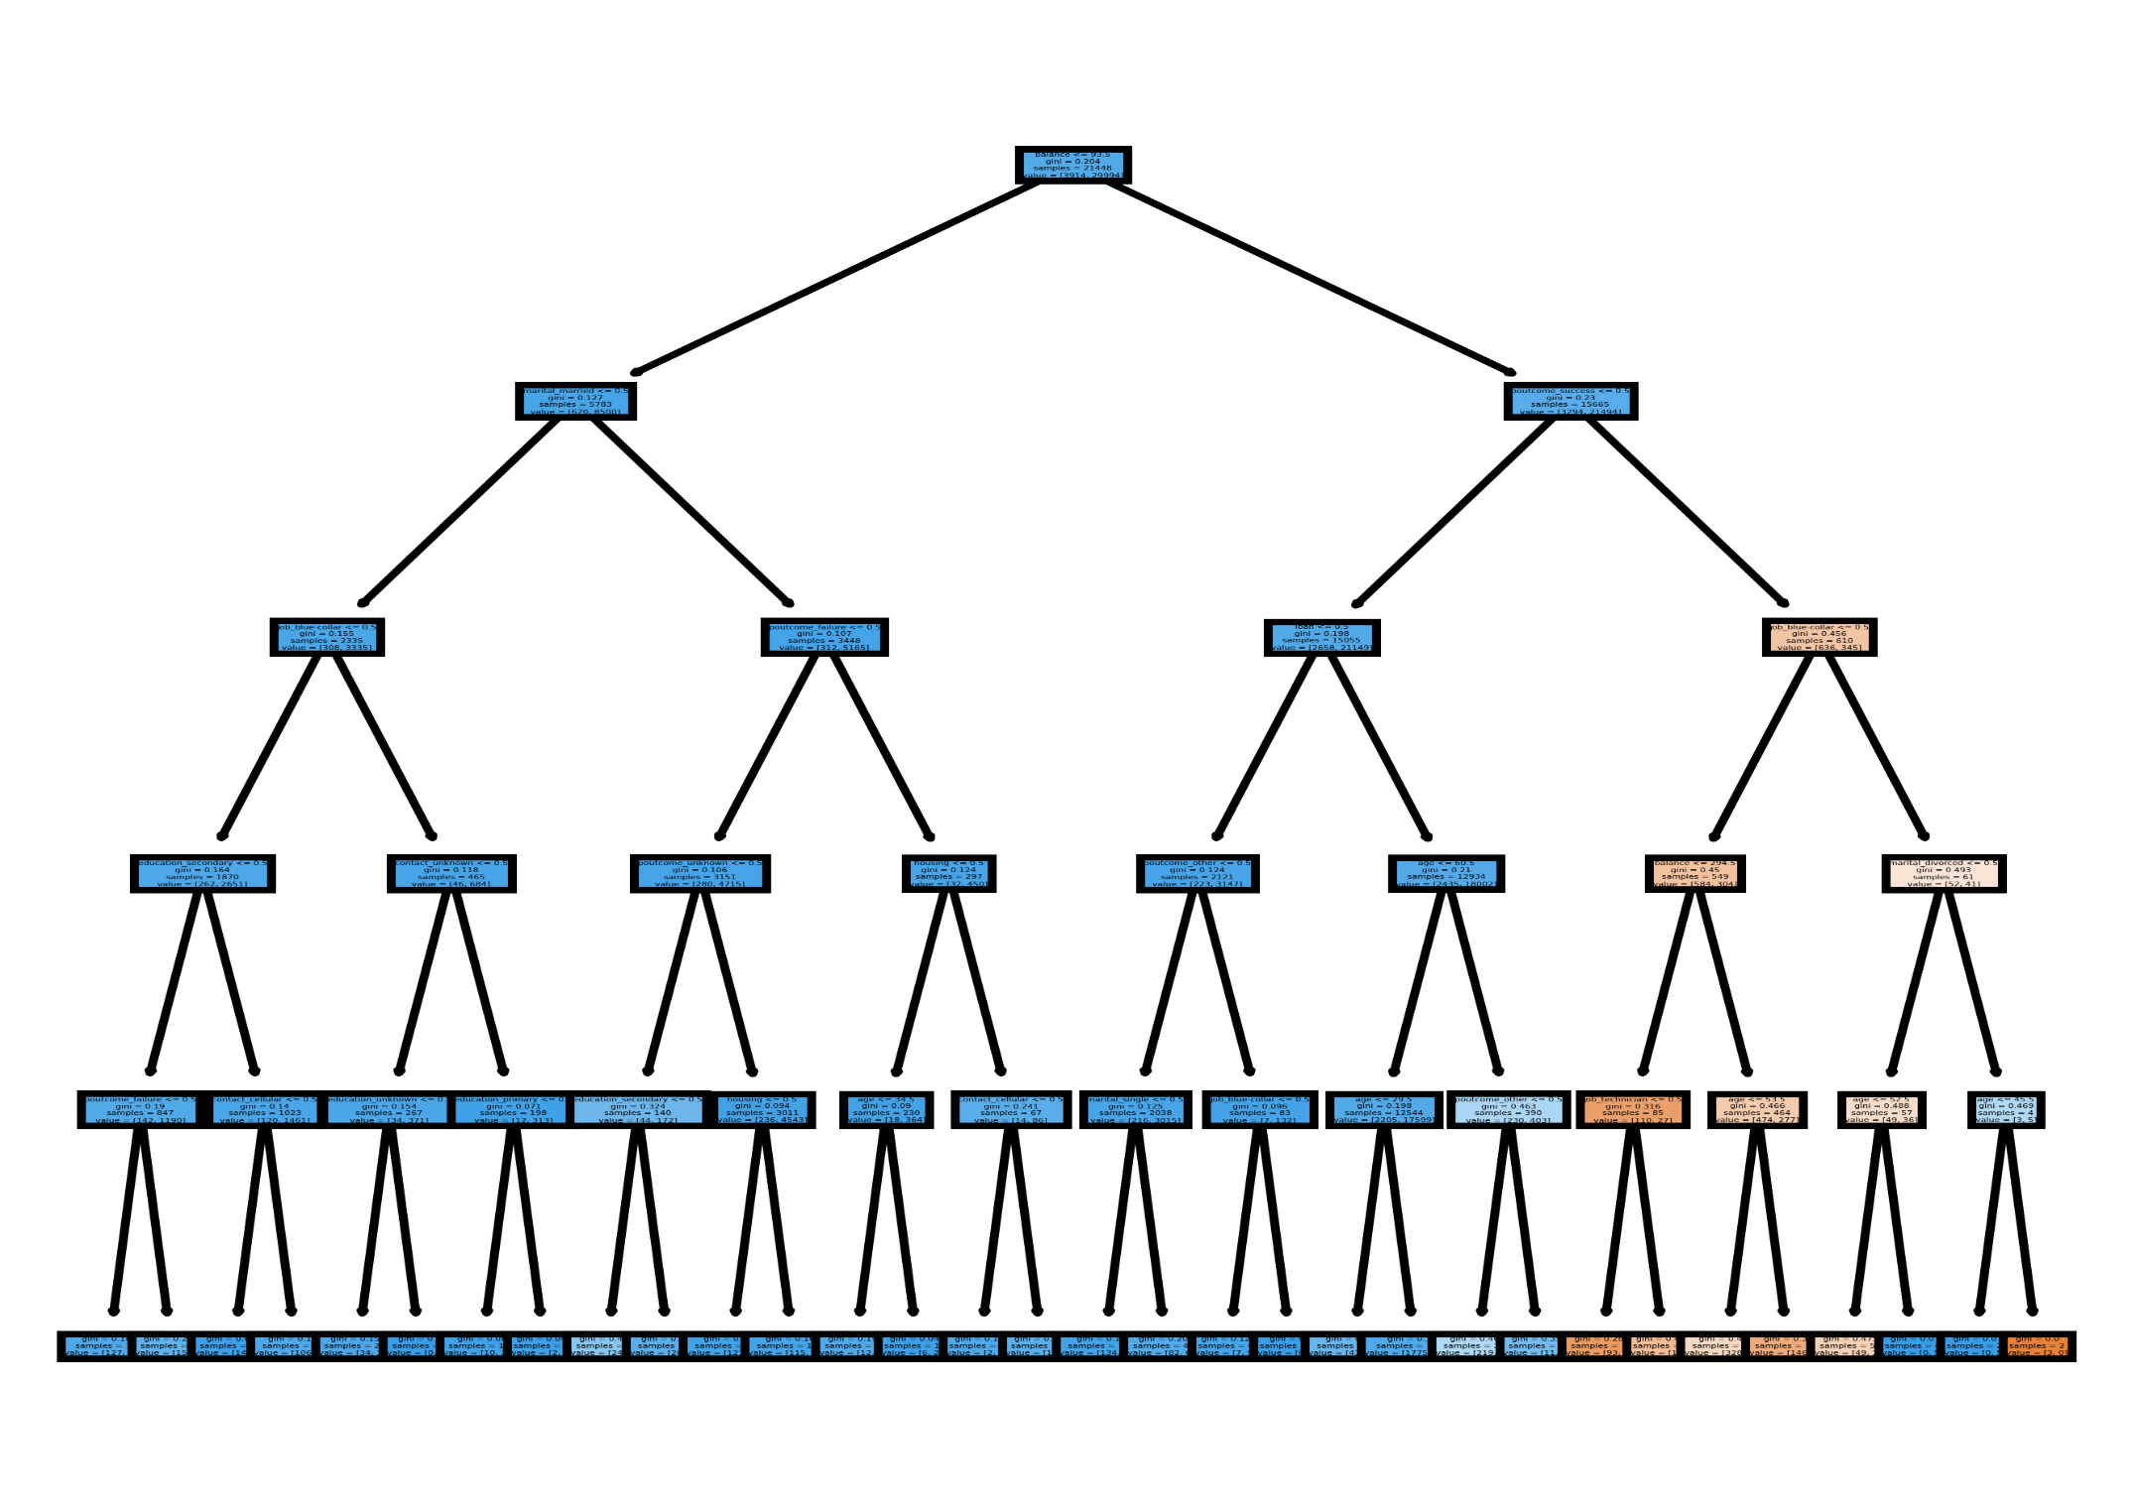
Visualisation of Random Forest Classifier Model
2
Notes:
It has a track record of training thousands of professionals successfully via classroom and online training.

Slide 14
Comparison of Model Performance
Evaluation of Models
2
Random Forest Classifier model is performing better than other models.
Notes:
It has a track record of training thousands of professionals successfully via classroom and online training.

Slide 15
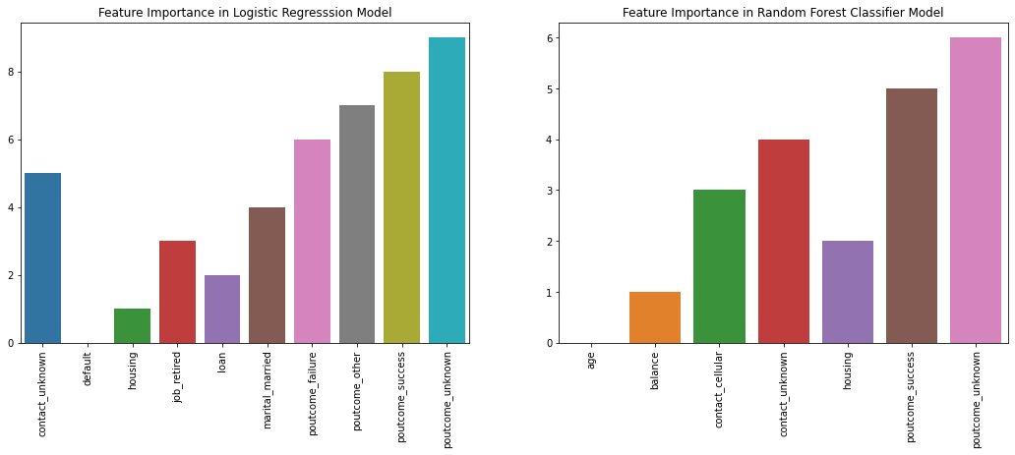
Important Features in Model
2
Notes:
It has a track record of training thousands of professionals successfully via classroom and online training.

Slide 16
Testing of model on Sample Dataset
Testing sample dataset on the Random Forest Classifier as it is performing best on the training dataset.
2
Evaluation of Models
One more thing we can conclude that model has no overfitting as the various evaluation metrics shows only minor change in values from training dataset and testing dataset
Notes:
It has a track record of training thousands of professionals successfully via classroom and online training.

Slide 17
Conclusion
By analyzing EDA & Features Importance, we can recommend that Banks should focus on –
Jobs: Management, technicians.
Marital status: Married.
Education: Secondary , tertiary.
Loans: Non defaulters , no housing & personal loan
Contact: Cellular
Age: 30-40 years.
2
Notes:
It has a track record of training thousands of professionals successfully via classroom and online training.

Slide 18
Thank you

